Slide 1
Chapter 7
SQL: Data Definition
Pearson Education © 2009

Slide 2
Chapter 7 - Objectives
Data types supported by SQL standard.
Purpose of integrity enhancement feature of SQL.
How to define integrity constraints using SQL.
How to use the integrity enhancement feature in the CREATE and ALTER TABLE statements.
Pearson Education © 2009

Slide 3
Chapter 7 - Objectives
Purpose of views.
How to create and delete views using SQL.
How the DBMS performs operations on views.
Under what conditions views are updatable.
Advantages and disadvantages of views.
How the ISO transaction model works.
How to use the GRANT and REVOKE statements as a level of security.
Pearson Education © 2009

Slide 4
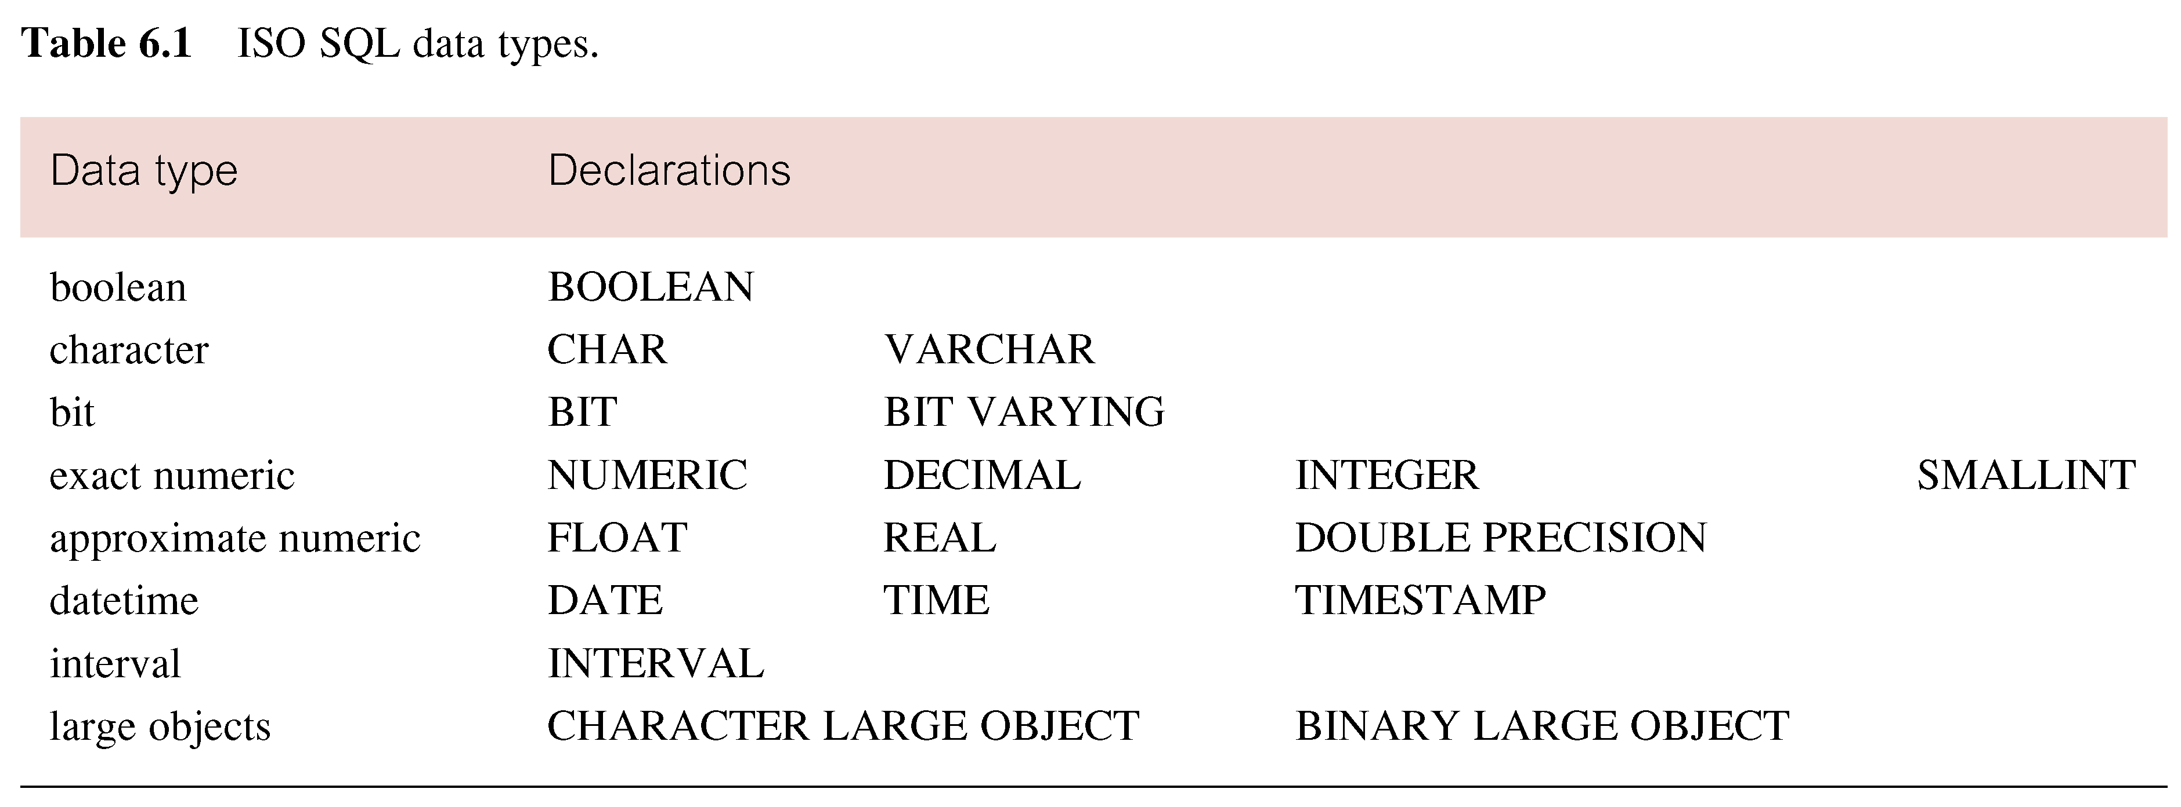
ISO SQL Data Types
Pearson Education © 2009

Slide 5
ISO SQL Data Types 2
Boolean can be T, F or NULL if allowed, also UNKNOWN as the NULL value
BIT used for binary bit strings of varying length
DATE: year, month and day
TIME: hour minute and seconds
TIMESTAMP: date and time with specified precision
INTERVAL: periods of time

Slide 6
Integrity Enhancement Feature
Consider five types of integrity constraints:
required data
domain constraints
entity integrity
referential integrity
general constraints.
Pearson Education © 2009

Slide 7
Integrity Enhancement Feature
Required Data
position VARCHAR(10) NOT NULL
Domain Constraints
(a) CHECK
sex CHAR NOT NULL
CHECK (sex IN (‘M’, ‘F’))
Pearson Education © 2009

Slide 8
Integrity Enhancement Feature
(b) CREATE DOMAIN
CREATE DOMAIN DomainName [AS] dataType
[DEFAULT defaultOption]
[CHECK (searchCondition)]
For example:
CREATE DOMAIN SexType AS CHAR
CHECK (VALUE IN (‘M’, ‘F’));
sex SexType NOT NULL
Pearson Education © 2009

Slide 9
Integrity Enhancement Feature
searchCondition can involve a table lookup:
CREATE DOMAIN BranchNo AS CHAR(4)
CHECK (VALUE IN (SELECT branchNo
FROM Branch));
Domains can be removed using DROP DOMAIN:
DROP DOMAIN DomainName
[RESTRICT | CASCADE]
Pearson Education © 2009

Slide 10
IEF - Entity Integrity
Primary key of a table must contain a unique, non-null value for each row.
ISO standard supports FOREIGN KEY clause in CREATE and ALTER TABLE statements:
PRIMARY KEY(staffNo)
PRIMARY KEY(clientNo, propertyNo)
Can only have one PRIMARY KEY clause per table. Can still ensure uniqueness for alternate keys using UNIQUE:
UNIQUE(telNo)
Pearson Education © 2009

Slide 11
IEF - Referential Integrity
FK is column or set of columns that links each row in child table containing foreign FK to row of parent table containing matching PK.
Referential integrity means that, if FK contains a value, that value must refer to existing row in parent table.
ISO standard supports definition of FKs with FOREIGN KEY clause in CREATE and ALTER TABLE:
FOREIGN KEY(branchNo) REFERENCES Branch
Pearson Education © 2009

Slide 12
IEF - Referential Integrity
Any INSERT/UPDATE attempting to create FK value in child table without matching CK value in parent is rejected.
Action taken attempting to update/delete a CK value in parent table with matching rows in child is dependent on referential action specified using ON UPDATE and ON DELETE subclauses:
CASCADE - SET NULL
SET DEFAULT - NO ACTION
Pearson Education © 2009

Slide 13
IEF - Referential Integrity
CASCADE: Delete row from parent and delete matching rows in child, and so on in cascading manner.
SET NULL: Delete row from parent and set FK column(s) in child to NULL. Only valid if FK columns are not set to NOT NULL.
SET DEFAULT: Delete row from parent and set each component of FK in child to specified default. Only valid if DEFAULT specified for FK columns.
NO ACTION: Reject delete from parent. Default.
Pearson Education © 2009

Slide 14
IEF - Referential Integrity
FOREIGN KEY (staffNo) REFERENCES Staff ON DELETE SET NULL
FOREIGN KEY (ownerNo) REFERENCES Owner ON UPDATE CASCADE
Pearson Education © 2009

Slide 15
IEF - General Constraints
Could use CHECK/UNIQUE in CREATE and ALTER TABLE.
Similar to the CHECK clause, also have:
CREATE ASSERTION AssertionName
CHECK (searchCondition)
Pearson Education © 2009

Slide 16
IEF - General Constraints
CREATE ASSERTION StaffNotHandlingTooMuch
CHECK (NOT EXISTS (SELECT staffNo
FROM PropertyForRent
GROUP BY staffNo
HAVING COUNT(*) > 100))
Pearson Education © 2009

Slide 17
Data Definition
SQL DDL allows database objects such as schemas, domains, tables, views, and indexes to be created and destroyed.
Main SQL DDL statements are:
CREATE SCHEMA DROP SCHEMA
CREATE/ALTER DOMAIN DROP DOMAIN
CREATE/ALTER TABLE DROP TABLE
CREATE VIEW DROP VIEW
Many DBMSs also provide:
CREATE INDEX DROP INDEX
Pearson Education © 2009

Slide 18
Data Definition
Relations and other database objects exist in an environment.
Each environment contains one or more catalogs, and each catalog consists of set of schemas.
Schema is named collection of related database objects.
Objects in a schema can be tables, views, domains, assertions, collations, translations, and character sets. All have same owner.
Pearson Education © 2009

Slide 19
CREATE SCHEMA
CREATE SCHEMA [Name |
AUTHORIZATION CreatorId ]
DROP SCHEMA Name [RESTRICT | CASCADE ]
With RESTRICT (default), schema must be empty or operation fails.
With CASCADE, operation cascades to drop all objects associated with schema in order defined above. If any of these operations fail, DROP SCHEMA fails.
Pearson Education © 2009

Slide 20
CREATE TABLE
CREATE TABLE TableName
{(colName dataType [NOT NULL] [UNIQUE]
[DEFAULT defaultOption]
[CHECK searchCondition] [,...]}
[PRIMARY KEY (listOfColumns),]
{[UNIQUE (listOfColumns),] […,]}
{[FOREIGN KEY (listOfFKColumns)
REFERENCES ParentTableName [(listOfCKColumns)],
[ON UPDATE referentialAction]
[ON DELETE referentialAction ]] [,…]}
{[CHECK (searchCondition)] [,…] })
Pearson Education © 2009

Slide 21
CREATE TABLE
Creates a table with one or more columns of the specified dataType.
With NOT NULL, system rejects any attempt to insert a null in the column.
Can specify a DEFAULT value for the column.
Primary keys should always be specified as NOT NULL.
FOREIGN KEY clause specifies FK along with the referential action.
Pearson Education © 2009

Slide 22
Example 7.1 - CREATE TABLE
CREATE DOMAIN OwnerNumber AS VARCHAR(5)
CHECK (VALUE IN (SELECT ownerNo FROM PrivateOwner));
CREATE DOMAIN StaffNumber AS VARCHAR(5)
CHECK (VALUE IN (SELECT staffNo FROM Staff));
CREATE DOMAIN PNumber AS VARCHAR(5);
CREATE DOMAIN PRooms AS SMALLINT;
CHECK(VALUE BETWEEN 1 AND 15);
CREATE DOMAIN PRent AS DECIMAL(6,2)
CHECK(VALUE BETWEEN 0 AND 9999.99);
Pearson Education © 2009

Slide 23
Example 7.1 - CREATE TABLE
CREATE TABLE PropertyForRent (
propertyNo PNumber NOT NULL, ….
rooms PRooms NOT NULL DEFAULT 4,
rent PRent NOT NULL, DEFAULT 600,
ownerNo OwnerNumber NOT NULL,
staffNo StaffNumber
Constraint StaffNotHandlingTooMuch ….
branchNo BranchNumber NOT NULL,
PRIMARY KEY (propertyNo),
FOREIGN KEY (staffNo) REFERENCES Staff
ON DELETE SET NULL ON UPDATE CASCADE ….);
Pearson Education © 2009

Slide 24
ALTER TABLE
Add a new column to a table.
Drop a column from a table.
Add a new table constraint.
Drop a table constraint.
Set a default for a column.
Drop a default for a column.
Pearson Education © 2009

Slide 25
Example 7.2(a) - ALTER TABLE
Change Staff table by removing default of ‘Assistant’ for position column and setting default for sex column to female (‘F’).
ALTER TABLE Staff
ALTER position DROP DEFAULT;
ALTER TABLE Staff
ALTER sex SET DEFAULT ‘F’;
Pearson Education © 2009

Slide 26
Example 7.2(b) - ALTER TABLE
Remove constraint from PropertyForRent that staff are not allowed to handle more than 100 properties at a time. Add new column to Client table.
ALTER TABLE PropertyForRent
DROP CONSTRAINT StaffNotHandlingTooMuch;
ALTER TABLE Client
ADD prefNoRooms PRooms;
Pearson Education © 2009

Slide 27
DROP TABLE
DROP TABLE TableName [RESTRICT | CASCADE]
e.g. DROP TABLE PropertyForRent;
Removes named table and all rows within it.
With RESTRICT, if any other objects depend for their existence on continued existence of this table, SQL does not allow request.
With CASCADE, SQL drops all dependent objects (and objects dependent on these objects).
Pearson Education © 2009

Slide 28
Views
View
Dynamic result of one or more relational operations operating on base relations to produce another relation.
Virtual relation that does not necessarily actually exist in the database but is produced upon request, at time of request.
Pearson Education © 2009

Slide 29
Views
Contents of a view are defined as a query on one or more base relations.
With view resolution, any operations on view are automatically translated into operations on relations from which it is derived.
With view materialization, the view is stored as a temporary table, which is maintained as the underlying base tables are updated.
Pearson Education © 2009

Slide 30
SQL - CREATE VIEW
CREATE VIEW ViewName [ (newColumnName [,...]) ]
AS subselect
[WITH [CASCADED | LOCAL] CHECK OPTION]
Can assign a name to each column in view.
If list of column names is specified, it must have same number of items as number of columns produced by subselect.
If omitted, each column takes name of corresponding column in subselect.
Pearson Education © 2009

Slide 31
SQL - CREATE VIEW
List must be specified if there is any ambiguity in a column name.
The subselect is known as the defining query.
WITH CHECK OPTION ensures that if a row fails to satisfy WHERE clause of defining query, it is not added to underlying base table.
Need SELECT privilege on all tables referenced in subselect and USAGE privilege on any domains used in referenced columns.
Pearson Education © 2009

Slide 32
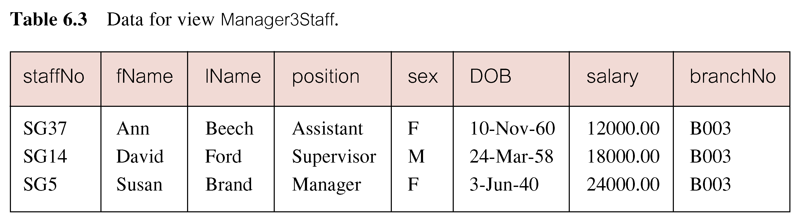
Example 7.3 - Create Horizontal View
Create view so that manager at branch B003 can only see details for staff who work in his or her office.
CREATE VIEW Manager3Staff
AS SELECT *
FROM Staff
WHERE branchNo = ‘B003’;
Pearson Education © 2009

Slide 33
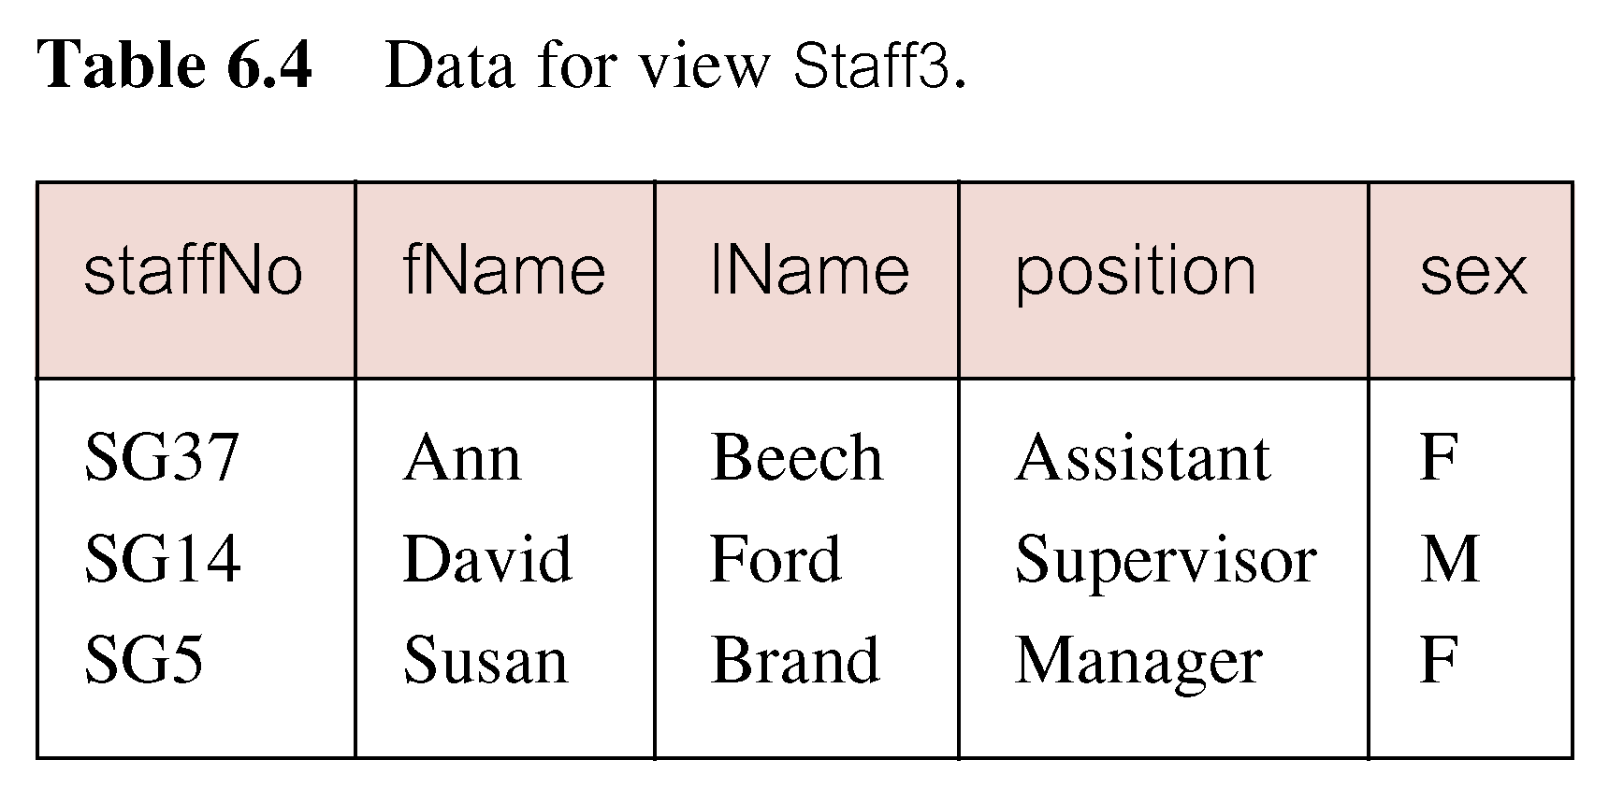
Example 7.4 - Create Vertical View
Create view of staff details at branch B003 excluding salaries.
CREATE VIEW Staff3
AS SELECT staffNo, fName, lName, position, sex
FROM Staff
WHERE branchNo = ‘B003’;
Pearson Education © 2009

Slide 34
Example 7.5 - Grouped and Joined Views
Create view of staff who manage properties for rent, including branch number they work at, staff number, and number of properties they manage.
CREATE VIEW StaffPropCnt (branchNo, staffNo, cnt)
AS SELECT s.branchNo, s.staffNo, COUNT(*)
FROM Staff s, PropertyForRent p
WHERE s.staffNo = p.staffNo
GROUP BY s.branchNo, s.staffNo;
Pearson Education © 2009

Slide 35
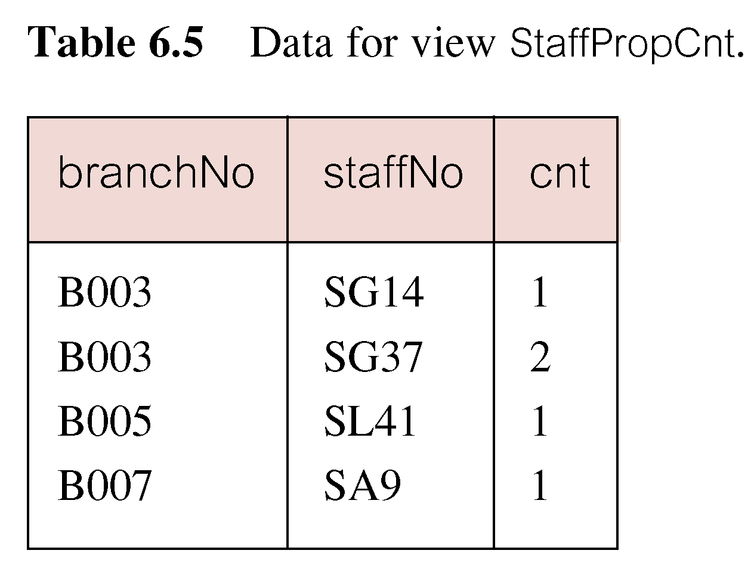
Example 7.3 - Grouped and Joined Views
Pearson Education © 2009

Slide 36
SQL - DROP VIEW
DROP VIEW ViewName [RESTRICT | CASCADE]
Causes definition of view to be deleted from database.
For example:
DROP VIEW Manager3Staff;
Pearson Education © 2009

Slide 37
SQL - DROP VIEW
With CASCADE, all related dependent objects are deleted; i.e. any views defined on view being dropped.
With RESTRICT (default), if any other objects depend for their existence on continued existence of view being dropped, command is rejected.
Pearson Education © 2009

Slide 38
View Resolution
Count number of properties managed by each member at branch B003.
SELECT staffNo, cnt
FROM StaffPropCnt
WHERE branchNo = ‘B003’
ORDER BY staffNo;
Pearson Education © 2009

Slide 39
View Resolution
(a) View column names in SELECT list are translated into their corresponding column names in the defining query:
SELECT s.staffNo As staffNo, COUNT(*) As cnt
(b) View names in FROM are replaced with corresponding FROM lists of defining query:
FROM Staff s, PropertyForRent p
Pearson Education © 2009

Slide 40
View Resolution
(c) WHERE from user query is combined with WHERE of defining query using AND:
WHERE s.staffNo = p.staffNo AND branchNo = ‘B003’
(d) GROUP BY and HAVING clauses copied from defining query:
GROUP BY s.branchNo, s.staffNo
(e) ORDER BY copied from query with view column name translated into defining query column name
ORDER BY s.staffNo
Pearson Education © 2009

Slide 41
View Resolution
(f) Final merged query is now executed to produce the result:
SELECT s.staffNo AS staffNo, COUNT(*) AS cnt
FROM Staff s, PropertyForRent p
WHERE s.staffNo = p.staffNo AND
branchNo = ‘B003’
GROUP BY s.branchNo, s.staffNo
ORDER BY s.staffNo;
Pearson Education © 2009

Slide 42
Restrictions on Views
SQL imposes several restrictions on creation and use of views.
(a) If column in view is based on an aggregate function:
Column may appear only in SELECT and ORDER BY clauses of queries that access view.
Column may not be used in WHERE nor be an argument to an aggregate function in any query based on view.
Pearson Education © 2009

Slide 43
Restrictions on Views
For example, following query would fail:
SELECT COUNT(cnt)
FROM StaffPropCnt;
Similarly, following query would also fail:
SELECT *
FROM StaffPropCnt
WHERE cnt > 2;
Pearson Education © 2009

Slide 44
Restrictions on Views
(b) Grouped view may never be joined with a base table or a view.
For example, StaffPropCnt view is a grouped view, so any attempt to join this view with another table or view fails.
Pearson Education © 2009

Slide 45
View Updatability
All updates to base table reflected in all views that encompass base table.
Similarly, may expect that if view is updated then base table(s) will reflect change.
Pearson Education © 2009

Slide 46
View Updatability
However, consider again view StaffPropCnt.
If we tried to insert record showing that at branch B003, SG5 manages 2 properties:
INSERT INTO StaffPropCnt
VALUES (‘B003’, ‘SG5’, 2);
Have to insert 2 records into PropertyForRent showing which properties SG5 manages. However, do not know which properties they are; i.e. do not know primary keys!
Pearson Education © 2009

Slide 47
View Updatability
If change definition of view and replace count with actual property numbers:
CREATE VIEW StaffPropList (branchNo,
staffNo, propertyNo)
AS SELECT s.branchNo, s.staffNo, p.propertyNo
FROM Staff s, PropertyForRent p
WHERE s.staffNo = p.staffNo;
Pearson Education © 2009

Slide 48
View Updatability
Now try to insert the record:
INSERT INTO StaffPropList
VALUES (‘B003’, ‘SG5’, ‘PG19’);
Still problem, because in PropertyForRent all columns except postcode/staffNo are not allowed nulls.
However, have no way of giving remaining non-null columns values.
Pearson Education © 2009

Slide 49
View Updatability
ISO specifies that a view is updatable if and only if:
- DISTINCT is not specified.
- Every element in SELECT list of defining query is a column name and no column appears more than once.
- FROM clause specifies only one table, excluding any views based on a join, union, intersection or difference.
- No nested SELECT referencing outer table.
- No GROUP BY or HAVING clause.
- Also, every row added through view must not violate integrity constraints of base table.
Pearson Education © 2009

Slide 50
Updatable View
For view to be updatable, DBMS must be able to trace any row or column back to its row or column in the source table.
Pearson Education © 2009

Slide 51
WITH CHECK OPTION
Rows exist in a view because they satisfy WHERE condition of defining query.
If a row changes and no longer satisfies condition, it disappears from the view.
New rows appear within view when insert/update on view cause them to satisfy WHERE condition.
Rows that enter or leave a view are called migrating rows.
WITH CHECK OPTION prohibits a row migrating out of the view.
Pearson Education © 2009

Slide 52
WITH CHECK OPTION
LOCAL/CASCADED apply to view hierarchies.
With LOCAL, any row insert/update on view and any view directly or indirectly defined on this view must not cause row to disappear from view unless row also disappears from derived view/table.
With CASCADED (default), any row insert/ update on this view and on any view directly or indirectly defined on this view must not cause row to disappear from the view.
Pearson Education © 2009

Slide 53
Example 7.6 - WITH CHECK OPTION
CREATE VIEW Manager3Staff
AS SELECT *
FROM Staff
WHERE branchNo = ‘B003’
WITH CHECK OPTION;
Cannot update branch number of row B003 to B002 as this would cause row to migrate from view.
Also cannot insert a row into view with a branch number that does not equal B003.
Pearson Education © 2009

Slide 54
Example 7.6 - WITH CHECK OPTION
Now consider the following:
CREATE VIEW LowSalary
AS SELECT * FROM Staff WHERE salary > 9000;
CREATE VIEW HighSalary
AS SELECT * FROM LowSalary
WHERE salary > 10000
WITH LOCAL CHECK OPTION;
CREATE VIEW Manager3Staff
AS SELECT * FROM HighSalary
WHERE branchNo = ‘B003’;
Pearson Education © 2009

Slide 55
Example 7.6 - WITH CHECK OPTION
UPDATE Manager3Staff
SET salary = 9500
WHERE staffNo = ‘SG37’;
This update would fail: although update would cause row to disappear from HighSalary, row would not disappear from LowSalary.
However, if update tried to set salary to 8000, update would succeed as row would no longer be part of LowSalary.
Pearson Education © 2009

Slide 56
Example 7.6 - WITH CHECK OPTION
If HighSalary had specified WITH CASCADED CHECK OPTION, setting salary to 9500 or 8000 would be rejected because row would disappear from HighSalary.
To prevent anomalies like this, each view should be created using WITH CASCADED CHECK OPTION.
Pearson Education © 2009

Slide 57
Advantages of Views
Data independence
Currency
Improved security
Reduced complexity
Convenience
Customization
Data integrity
Pearson Education © 2009

Slide 58
Disadvantages of Views
Update restriction
Structure restriction
Performance
Pearson Education © 2009

Slide 59
View Materialization
View resolution mechanism may be slow, particularly if view is accessed frequently.
View materialization stores view as temporary table when view is first queried.
Thereafter, queries based on materialized view can be faster than recomputing view each time.
Difficulty is maintaining the currency of view while base tables(s) are being updated.
Pearson Education © 2009

Slide 60
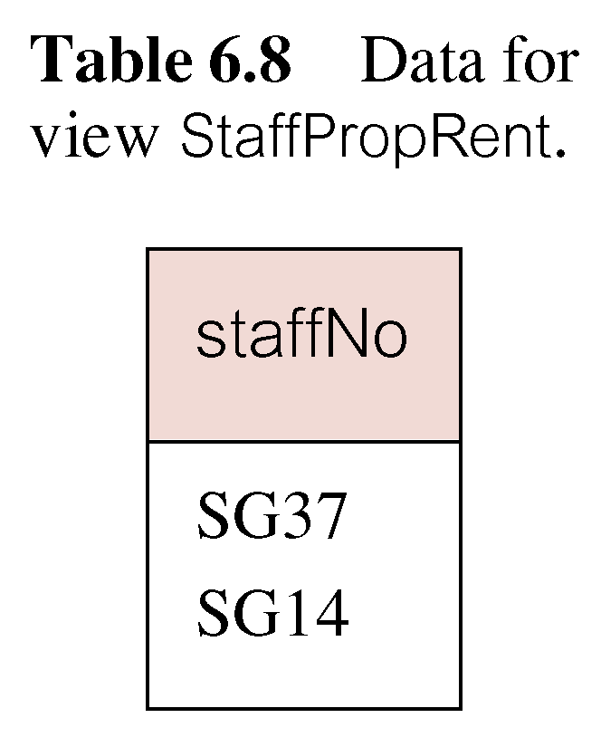
View Maintenance
View maintenance aims to apply only those changes necessary to keep view current.
Consider following view:
CREATE VIEW StaffPropRent(staffNo)
AS SELECT DISTINCT staffNo
FROM PropertyForRent
WHERE branchNo = ‘B003’ AND
rent > 400;
Pearson Education © 2009

Slide 61
View Materialization
If insert row into PropertyForRent with rent ≤400 then view would be unchanged.
If insert row for property PG24 at branch B003 with staffNo = SG19 and rent = 550, then row would appear in materialized view.
If insert row for property PG54 at branch B003 with staffNo = SG37 and rent = 450, then no new row would need to be added to materialized view.
If delete property PG24, row should be deleted from materialized view.
If delete property PG54, then row for PG37 should not be deleted (because of existing property PG21).
Pearson Education © 2009

Slide 62
Transactions
SQL defines transaction model based on COMMIT and ROLLBACK.
Transaction is logical unit of work with one or more SQL statements guaranteed to be atomic with respect to recovery.
An SQL transaction automatically begins with a transaction-initiating SQL statement (e.g., SELECT, INSERT).
Changes made by transaction are not visible to other concurrently executing transactions until transaction completes.
Pearson Education © 2009

Slide 63
Transactions
Transaction can complete in one of four ways:
- COMMIT ends transaction successfully, making changes permanent.
- ROLLBACK aborts transaction, backing out any changes made by transaction.
- For programmatic SQL, successful program termination ends final transaction successfully, even if COMMIT has not been executed.
- For programmatic SQL, abnormal program end aborts transaction.
Pearson Education © 2009

Slide 64
Transactions
New transaction starts with next transaction-initiating statement.
SQL transactions cannot be nested.
SET TRANSACTION configures transaction:
SET TRANSACTION
[READ ONLY | READ WRITE] |
[ISOLATION LEVEL READ UNCOMMITTED |
READ COMMITTED|REPEATABLE READ |SERIALIZABLE ]
Pearson Education © 2009

Slide 65
Immediate and Deferred Integrity Constraints
Do not always want constraints to be checked immediately, but instead at transaction commit.
Constraint may be defined as INITIALLY IMMEDIATE or INITIALLY DEFERRED, indicating mode the constraint assumes at start of each transaction.
In former case, also possible to specify whether mode can be changed subsequently using qualifier [NOT] DEFERRABLE.
Default mode is INITIALLY IMMEDIATE.
Pearson Education © 2009

Slide 66
Immediate and Deferred Integrity Constraints
SET CONSTRAINTS statement used to set mode for specified constraints for current transaction:
SET CONSTRAINTS
{ALL | constraintName [, . . . ]}
{DEFERRED ¦ IMMEDIATE}
Pearson Education © 2009

Slide 67
Access Control - Authorization Identifiers and Ownership
Authorization identifier is normal SQL identifier used to establish identity of a user. Usually has an associated password.
Used to determine which objects user may reference and what operations may be performed on those objects.
Each object created in SQL has an owner, as defined in AUTHORIZATION clause of schema to which object belongs.
Owner is only person who may know about it.
Pearson Education © 2009

Slide 68
Privileges
Actions user permitted to carry out on given base table or view:
SELECT Retrieve data from a table.
INSERT Insert new rows into a table.
UPDATE Modify rows of data in a table.
DELETE Delete rows of data from a table.
REFERENCES Reference columns of named table in integrity constraints.
USAGE Use domains, collations, character sets, and translations.
Pearson Education © 2009

Slide 69
Privileges
Can restrict INSERT/UPDATE/REFERENCES to named columns.
Owner of table must grant other users the necessary privileges using GRANT statement.
To create view, user must have SELECT privilege on all tables that make up view and REFERENCES privilege on the named columns.
Pearson Education © 2009

Slide 70
GRANT
GRANT {PrivilegeList | ALL PRIVILEGES}
ON ObjectName
TO {AuthorizationIdList | PUBLIC}
[WITH GRANT OPTION]
PrivilegeList consists of one or more of above privileges separated by commas.
ALL PRIVILEGES grants all privileges to a user.
Pearson Education © 2009

Slide 71
GRANT
PUBLIC allows access to be granted to all present and future authorized users.
ObjectName can be a base table, view, domain, character set, collation or translation.
WITH GRANT OPTION allows privileges to be passed on.
Pearson Education © 2009

Slide 72
Example 7.7/8 - GRANT
Give Manager full privileges to Staff table.
GRANT ALL PRIVILEGES
ON Staff
TO Manager WITH GRANT OPTION;
Give users Personnel and Director SELECT and UPDATE on column salary of Staff.
GRANT SELECT, UPDATE (salary)
ON Staff
TO Personnel, Director;
Pearson Education © 2009

Slide 73
Example 7.9 - GRANT Specific Privileges to PUBLIC
Give all users SELECT on Branch table.
GRANT SELECT
ON Branch
TO PUBLIC;
Pearson Education © 2009

Slide 74
REVOKE
REVOKE takes away privileges granted with GRANT.
REVOKE [GRANT OPTION FOR]
{PrivilegeList | ALL PRIVILEGES}
ON ObjectName
FROM {AuthorizationIdList | PUBLIC}
[RESTRICT | CASCADE]
ALL PRIVILEGES refers to all privileges granted to a user by user revoking privileges.
Pearson Education © 2009

Slide 75
REVOKE
GRANT OPTION FOR allows privileges passed on via WITH GRANT OPTION of GRANT to be revoked separately from the privileges themselves.
REVOKE fails if it results in an abandoned object, such as a view, unless the CASCADE keyword has been specified.
Privileges granted to this user by other users are not affected.
Pearson Education © 2009

Slide 76
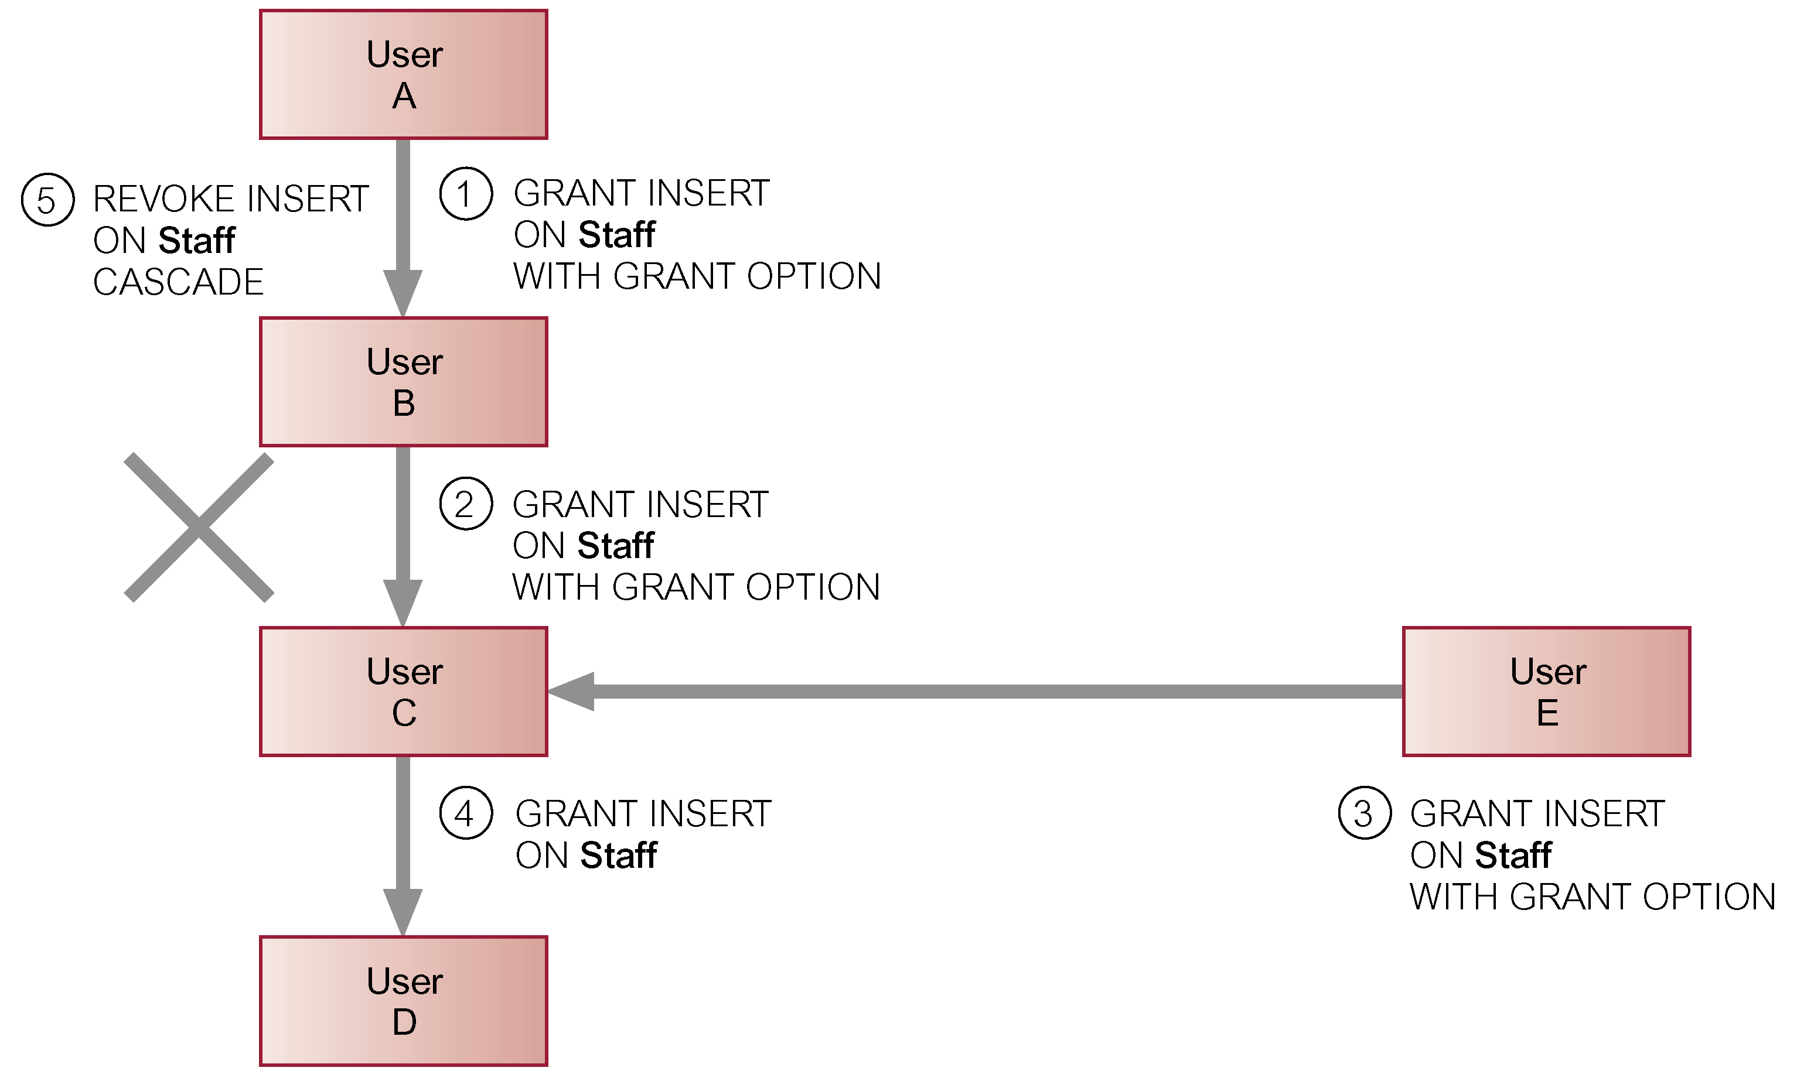
REVOKE
Pearson Education © 2009

Slide 77
Example 7.10/11 - REVOKE Specific Privileges
Revoke privilege SELECT on Branch table from all users.
REVOKE SELECT
ON Branch
FROM PUBLIC;
Revoke all privileges given to Director on Staff table.
REVOKE ALL PRIVILEGES
ON Staff
FROM Director;
Pearson Education © 2009

